Slide 1
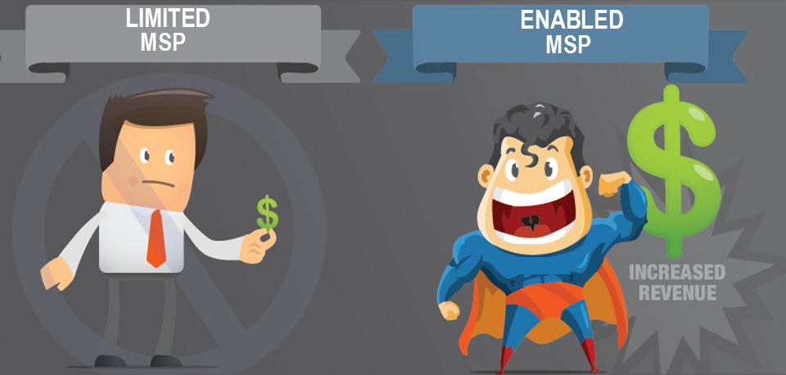

HOW TO USE MARKETING AND SALES AUTOMATION TO GENERATE LEADS AND CLOSE MORE CLOUD AND MANAGED SERVICES AGREEMENTS

Slide 2

Harbinder Khera
CEO, Mindmatrix Inc.
Harbinder Khera has over 20 years of experience in sales enablement and marketing automation software development. He has provided IT consulting services to Southwest Airlines, Nationwide Insurance, IBM, Siemens, Citibank, and Sprint PCS. Harbinder has an MS in Information Networking from Carnegie Mellon University (CMU), and an MS in Computer Engineering from Florida Atlantic University. He has published numerous articles in the IEEE conference proceedings and has presented at various conferences in the field of wireless and high-speed networks. He is a member of Phi Kappa Phi honor society and a member of the Dean’s Leadership Council at CMU.

Slide 3
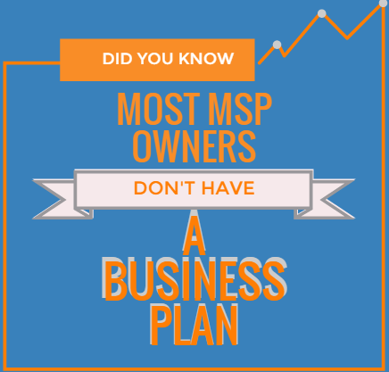
No experience in sales and marketing
Lack of sales and marketing resources
Too busy working in the business rather than on the business
No sales and marketing plans in place

Slide 4
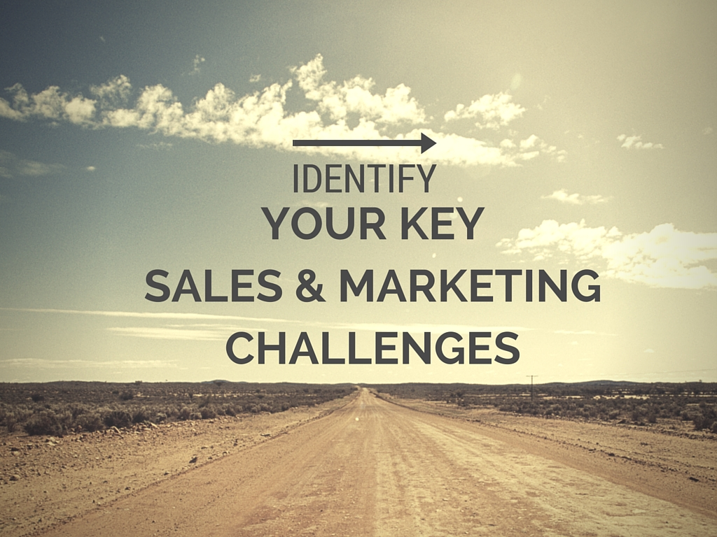

Slide 5
Lead generation
Getting appointments
Lacking social/web leads
Natural lead generation
Know the source of each lead
Examine the cost per lead, per source
Determine which lead source is most effective

Slide 6
Poor marketing support
Inability to engage leads with quality content
Lack of timely marketing support
Poor lead quality
Know the source of each lead
Examine the cost per lead, per source
Determine which lead source is most effective
Poor lead insight

Slide 7
Customer retention
Poor customer support
Inability to engage customers post-sale
No insight into customer activity
Know the source of each lead
Examine the cost per lead, per source
Determine which lead source is most effective

Slide 8
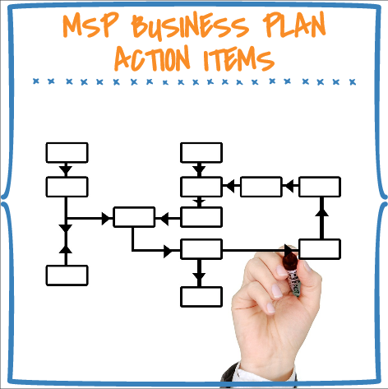

Slide 9
How to grow your business?
Ways to grow your business
Generate new business
Optimize existing business opportunities
Attract new leads
Build new partnerships
Upsell/cross-sell to existing accounts
Migrate from break/fix to MRR customers
Add/modify existing offerings

Slide 10

Analyze your customer base & reflect
What are the key customer verticals that you serve?
Law firms
Doctor’s offices
Number of customers per vertical
Which is most revenue generating?
Architectural & Construction firms
Call centers
Accounting firms
Financial services firms
Real Estate
Study each vertical
Which is the easiest to close?
Which is the easiest to service?
Who are most satisfied customers?
What is the market size of each of them?
What’s your USP that separates you from your competitors?
What won you those deals?
What are you best at?
Was it your vertical expertise or relationships?

Slide 11
IT Challenges faced by various industry verticals
Law firms | Doctor’s office | AECs | CPA/ Accounting firms | Real estate firms | Call centers | Financial services firms
Accessibility Security Multiple offices Lack of knowledge Application updates and back-ups Remote access to their systems even when they are traveling or in a meeting | Inability to hire full-time or even part-time IT staff Governmental regulations (ANSI5010 standard of billing, Electronic Health Records maintenance (EHR), HIPAA 2012, ICD-10 ) Patient’s rights & expectations (Patient Portals) | Work sharing applications Speed, transparency and collaboration Document management and work flow systems Need to maximize IT environment for productivity Client access to portals IT complexity Application upgrades | Software upgrades Data back-up, Remote access and security IT hassles and management costs | Economy Employee turn-over 24/7 web presence and MLS listing access Document storage & management Multiple branches and sources of communication Software upgrades and regulations | Multiple software programs Need to be accessible 24/7 Data availability and remote access Data mix-up Unforeseen call spikes | Mergers and acquisitions Payment portals and localized sites Data sensitivity and maintenance

Slide 12
Develop a strategic sales and marketing plan
Sources to generate new business
LinkedIn or Facebook groups
Local newspapers
Local business groups and trade associations
Yellow pages
Develop partnerships and build a stronger sales network
Incoming web leads

Slide 13
Track your prospect flow
Know the source of each lead
Examine the cost per lead, per source
Determine which lead source is most effective
Know the source of each lead
Examine the cost per lead, per source
Determine which lead source is most effective

Slide 14
Analyze your sales & marketing funnel
Closely examine the conversion rates from MQLs to SQLs to customers
Align your marketing and sales strategies to match your revenue goals
Calculate the conversion rate at every level of your sales funnel
Know the source of each lead
Examine the cost per lead, per source
Determine which lead source is most effective

Slide 15


Understand how you treat your leads
How do you deal with leads that don’t close immediately?
Do you have a lead nurturing program in place?
If yes, then how do you nurture your leads?
Know the source of each lead
Examine the cost per lead, per source
Determine which lead source is most effective

Slide 16
Cross selling and upselling
Do you engage in cross selling and up-selling?
Do you tap referrals as a lead source?
If yes, what is the process that you follow?
Know the source of each lead
Examine the cost per lead, per source
Determine which lead source is most effective

Slide 17
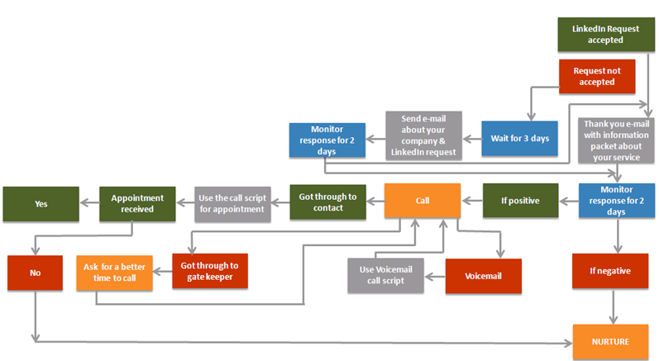
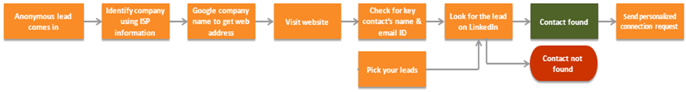
Sample action plan for tackling new leads
Yellow pages
Local Newspapers
Local business groups and Trade associations
LinkedIn & Facebook groups

Slide 18
Building your brand & growing your business
Website SEO
Ensure your website shows up in relevant web searches
Be active on social media
Email campaigns
Engage in consistent email communication with your prospects and customers
Engage your prospects and customers by creating and sharing share value
Generate value adding content and share with your customers and prospects
LinkedIn, Twitter and Facebook are great platforms to build your brand and also to attract leads.
Engage with your customers and prospects consistently on social media
When drafting your web content pay special attention to keywords, titles, descriptions, headings and alt texts
Don’t overtly sell on social media, rather use it as a medium to announce your presence
Nurture leads not ready to buy immediately
Email existing customers asking for their feedback, testimonials and referrals
Examples include whitepapers, eguides, relevant blog pieces, zero day alerts etc.

Slide 19
Refine your sales process
6-8 touch points
Stay in touch with your prospects across multiple touch points, at regular intervals
Asset inventory
Personalize
Take stock of the assets that you already have
Identify the assets that you need
Develop a game-plan to bridge the gap between what you have and what you need
Identify the specific requirements of your prospects and develop personalized sales and marketing communication for them
Lead management
Segment your leads based on their purchase readiness level and their position on the sales cycle
Develop marketing/sales plan for leads at different stages of the sales cycle
Identify the key milestones in your sales cycle

Slide 20
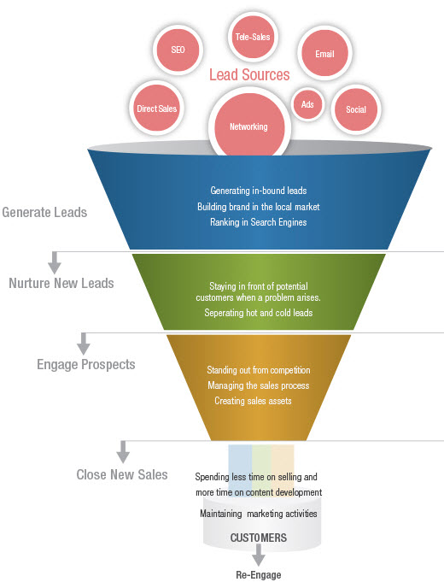
HOW THE MSP ADVANTAGE PROGRAM ADDS VALUE TO YOUR SALES FUNNEL AT EVERY LEVEL

Slide 21

HELPS BUILD LOCAL BRAND, GENERATE LEADS, OUTSOURCED CMO
Email Marketing
Landing Pages for lead Capture
Social Media Automation
Lead Management
Web tracking
MSP advantage Yellowpage /LinkedIn tool
Platform
Blogs
Social Content
Emails
Day 0 alerts - Power messages
Newsletter Content
E-guides
Branded Content
SEO reports/Directory submissions
Sending emails
Importing contacts
Coaching & best practice discussions
Editing landing pages
Data cleanup and migration
Editing templates with personalized content
Generate marketing reports
Sales & Marketing Concierge services
Automated Contact Synchronization with Autotask

Slide 22
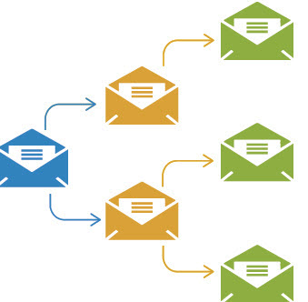
ENGAGE EXISTING CUSTOMERS AND PROSPECTS AND IMPROVE SALES VELOCITY
Lead nurturing drip campaigns
Automated lead scoring and routing
Platform
Pre-packaged drip asset
Branded Content
Send warm leads to PSA
PSA integration with Autotask

Slide 23
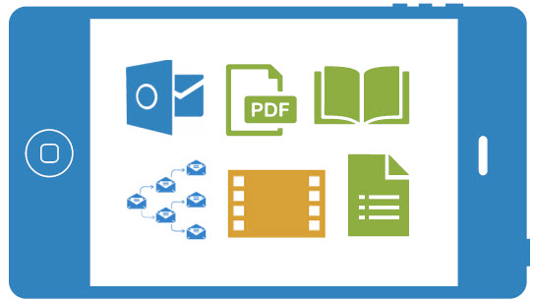

EFFICIENT AND EFFECTIVE SELLING
Real time Hot lead alerts
360 View of prospect behavior
Sales Playbooks with actionable sales process &
assets
Outlook and Gmail plugin for tracking
Automated Sales Prospecting
LinkedIn Lead Generation
Mobile App for instant access to leads
Platform
Sales process
Vertical-centric brochures
PPTs
Branded Content
Sales and marketing coaching
Data scrubbing
Importing and Organizing leads
Sales & Marketing Concierge service
Send opportunities/tasks to Autotask

Slide 24
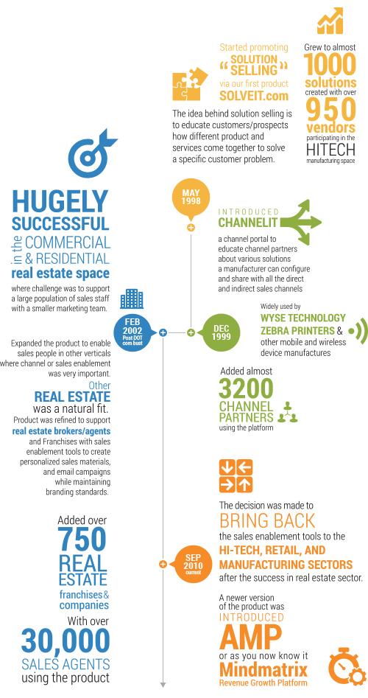
Company overview
Founded in 1998, Mindmatrix provides a Sales and Marketing Enablement Platform for direct sales, channels, dealers, brokers and reps helping them sell more.
Only Mindmatrix supports sales and marketing teams throughout the entire buyer’s journey – Lead to Revenue using Asset Management, Sales Enablement, Marketing Automation and Channel Enablement functionalities.
With Mindmatrix, sales & channel managers, and corporate marketing enjoy improved visibility into sales activities, channel engagement, lead performance, and asset effectiveness.

Slide 25
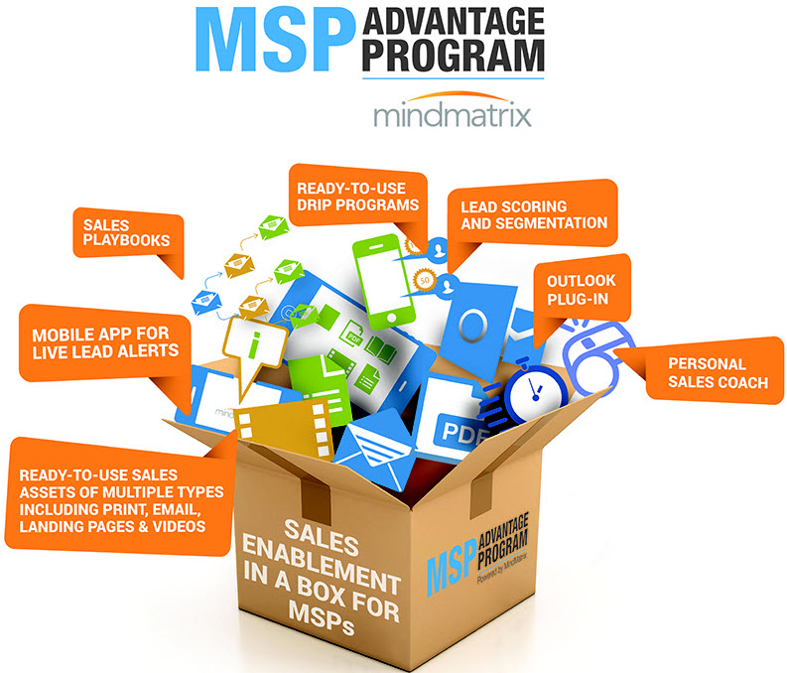

CONTACT US TO LEARN WHY
2403 Sidney Street, Suite 150 | Pittsburgh, PA 15203 |
Phone: 412.381.0230 | Fax: 412.774.1992

